Slide 1

Building Resilience During Times of Stress & Anxiety

Slide 2

How Many People Experience Anxiety Today?
18% of adults had anxiety in 2018.
- National Institute of Mental
Health
60% of adults experience stress and anxiety today.
- Gallup Report 2020
1 in 3 teens have anxiety.
- National Institute of Mental
Health
Anxiety disorders are the most common mental illness in the US.

Slide 3

What Is Your Source of Stress and Anxiety?
Divorce
Job Loss
Financial Issues
IRS
Noisy Neighbors
Sugar
Alcohol
Lack of Sleep
Coffee
Health Concerns

Slide 4


Another Look At Your Source of Anxiety
Has it ever occurred to you that what you eat could be causing anxiety?
Perhaps your source of anxiety is your breakfast coffee and pastry?
Or could it be your energy drink in the middle of your day?
Could your source of anxiety be a lifestyle habit?
Skipping lunch
Staying up too late
Living on fast food
Self-medicating
with alcohol
https://www.mayoclinic.org/diseases-conditions/generalized-anxiety-disorder/expert-answers/coping-with-anxiety/faq-20057987

Slide 5

Signs and Symptoms of Anxiety
For Adults:
Sleep Problems
Fatigue
Headaches
Stomach Issues
Worry
Fear
Craving Sugar or Processed Carbs
For Teens:
Irritability
Anger

Slide 6





Tools To Manage Anxiety
and Build Resilience
Eat A Balanced Breakfast
Reduce or Eliminate Sugar & Processed Carbs
Drink 8-10 Glasses of Filtered Water Daily
Sleep 8½-9 Hours Most Nights
Eat Sufficient Amounts of Protein
Avoid Refined Oils
Eat A Variety of Vegetables
Avoid MSG & Other Food Chemicals

Slide 7
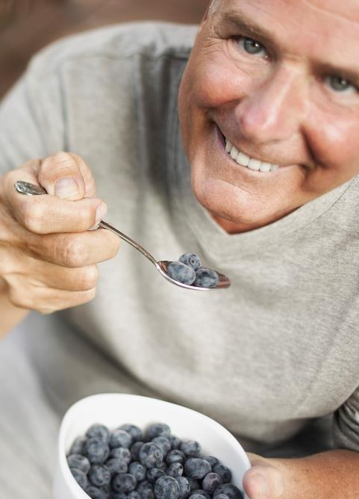

Have you made the connection between your nutrition and your anxiety?
How many of you believe there is a connection between your nutrition and your anxiety?

Slide 8



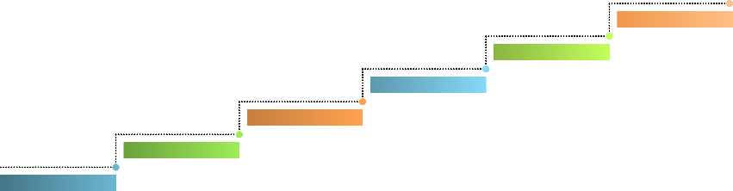



Steps to Build Resilience
STEP 6
STEP 5
Sleep 7½-8 hours each night.
STEP 4
STEP 3
Eat every
2-3 hours.
Feed your
brain healthy fats.
STEP 2
STEP 1
Cut back on caffeine.
Reduce or eliminate
sugary artificial sweeteners and processed carbs.
Eat breakfast.

Slide 9


Did Your
Breakfast
Create Anxiety or Did It Make You Feel Balanced
& Calm?

Slide 10
An Anxiety-Producing Breakfast
I forgot to eat!

Slide 11
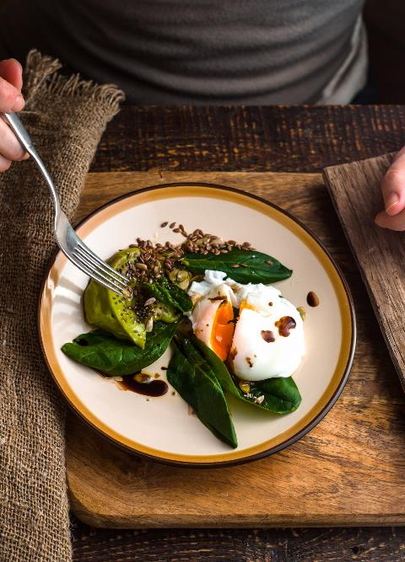
A Breakfast
To Build Resilience

Slide 12
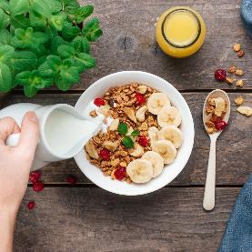
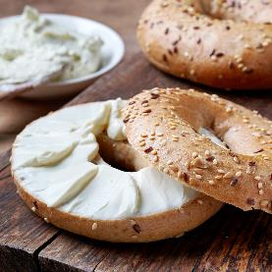
A Typical American Breakfast
=
Anxiety and Depression

Slide 13
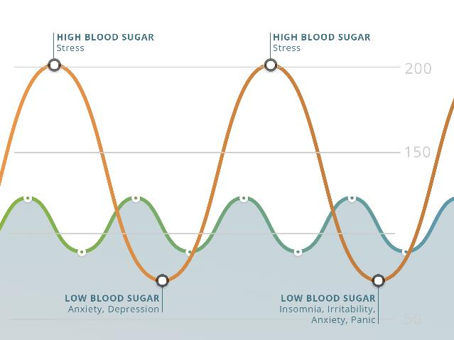
High Blood Sugar =
High Stress & Anxiety

Slide 14
Low Blood Sugar =
Anxiety, Irritability, & Insomnia

Slide 15








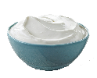
Foods to Build Resilience
& Reduce Anxiety
BREAKFAST
Turkey Sausage, Green Beans, Butter
SNACK
Cottage Cheese,
Berries, Almonds
LUNCH
Chili, Veggies & Beans, Sour Cream

Slide 16







More Anxiety-Reducing
Meals & Snacks
SNACK
Chicken Leg,
½ Sweet Potato, Butter
DINNER
Salmon Cake, Asparagus,
Olive Oil
BEDTIME SNACK
½ Apple,
Almond Butter

Slide 17
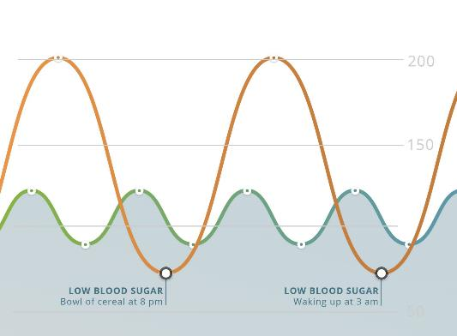
Low Blood Sugar Leads To
Poor Sleep & Anxious Nights
Anxiety
Hunger
Cravings
Depression
Fatigue/weakness
Irritability
Panic attacks
Insomnia
PMS moodiness
Cry easily
Night sweats

Slide 18
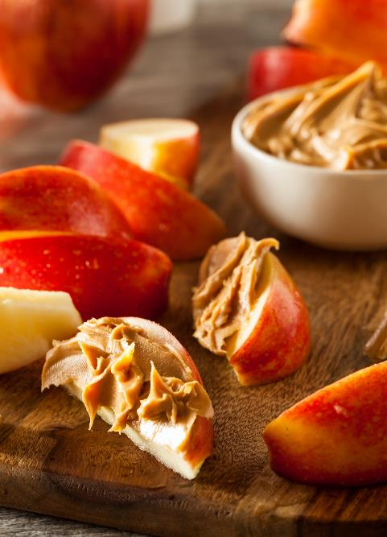
Balanced
Bedtime Snack
=
Better Sleep

Slide 19

40% of adults say they lie awake at night because of stress and anxiety.

Slide 20
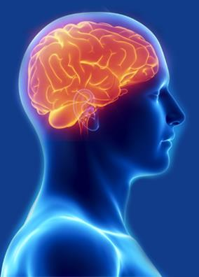
Your Brain
On Food
Food directly affects the structure and function of your brain and your resilience to stress and anxiety.
Your brain is always “on.” It takes care of your thoughts, your breathing, your heartbeat, how you manage stress and anxiety. Your brain requires a constant supply of nutrients from food.
Nutrition Psychiatry: Your Brain on Food, Eva Selhub, MD,
Harvard Medical School Health Blog, March 26, 2020

Slide 21

Food Makes
A Difference
Eat a balanced breakfast
Eat 4-5 meals a day, including protein
Stay away from refined fats and oils
  Avoid soybean oil, corn oil, canola oil, and cottonseed oil
Begin replacing man-made foods with real foods
  Grass-fed meat, wild-caught fish, organic vegetables
Choose natural beneficial fats
  Butter, olive oil, avocado oil, coconut oil, nuts, seeds, olives, avocados
Nutrition Psychiatry: Your Brain on Food, Eva Selhub, MD, Harvard Medical School Health Blog, March 26, 2020

Slide 22
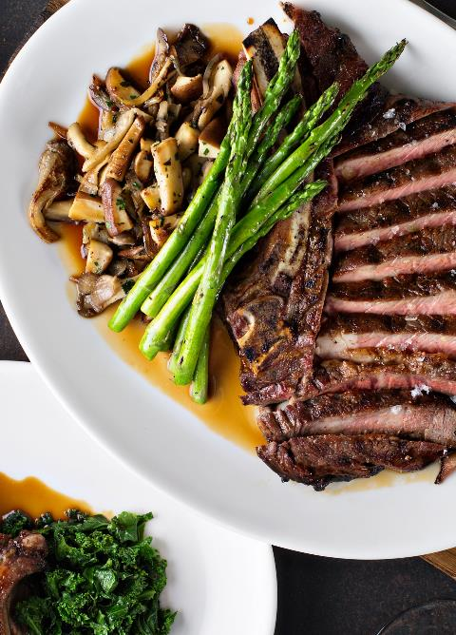
Protein: The
Building Block
For Brain Function
Protein
Amino Acids
Brain Chemicals
Memory, Focus, Mood,
Energy, Concentration

Slide 23

Animal protein provides the nutrients for
healthy brain function and resiliency.

Slide 24



The
Gut/Brain Connection
85% Good Bacteria = Resiliency
15% Bad Bacteria = Anxiety or Mood Disorders
Effects of requiring intestinal microbiota on anxiety symptoms: A Systematic Review/General Psychiatry https://gpsych.bmj.com/content/32/2/e100056

Slide 25
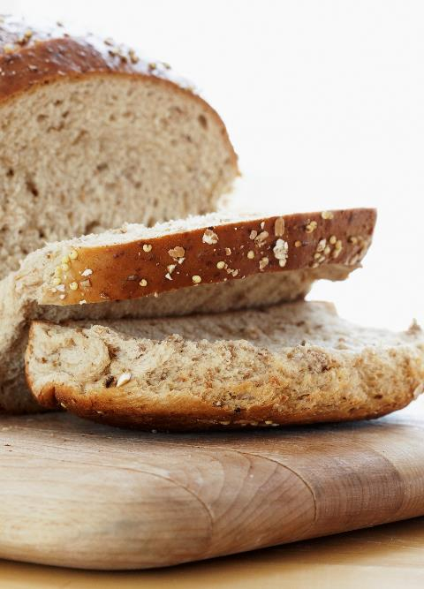
What Can Damage Beneficial Intestinal Bacteria and Reduce Resiliency?
Artificial Sweeteners
Antibiotics
GMOs
Gluten
NSAIDs
Acid-Reflux Drugs

Slide 26
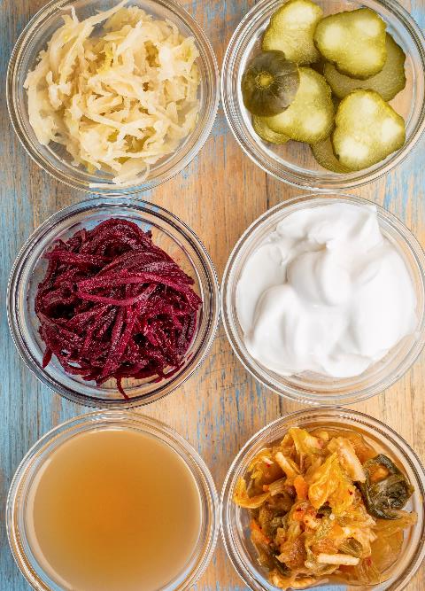
Foods and Supplements That Provide Beneficial Bacteria
Plain Yogurt
Sauerkraut
Kimchi
Miso
Kombucha
Probiotics
  Acidophilus
  Bifido

Slide 27
It’s All Connected
Thyroid Function
Brain Function
Mood, Memory, Depression, Anxiety
Blood Sugar Regulation
Hormonal
Balance
Immune Function
Inflammation, Resistance to Infections
Cravings
Sugar, Processed Carbs
A healthy intestinal tract is connected to all of our organs and helps
to build resilience for a healthy body and brain.

Slide 28










Drink Water For
Wellness & Body Balance
Strength
Skin Support
Productivity Boost
Toxin Removal
Joint
Support
Brain
Boost
Weight
Loss
Lower Blood Pressure
Fatigue Buster
Constipation Prevention

Slide 29



Water is lost through breathing, urination, and perspiration.
Intestines
Breathing
½ Glass
1 1/3 Glasses
Skin
Lungs
Water Required By The Body & Brain
2 Glasses
2 Glasses
Kidneys
5 ½ Glasses

Slide 30
What Step Are You On?
STEP 6
STEP 5
Sleep 7½-8 hours each night.
STEP 4
STEP 3
Eat every
2-3 hours.
Feed your
brain healthy fats.
STEP 2
STEP 1
Cut back on caffeine.
Reduce or eliminate
sugary artificial sweeteners and processed carbs.
Eat breakfast.

