Slide 1
The Neurobiology of Addiction & Trauma:
Intricate Links
Presented by:
Carol Ackley, LADC

Slide 2
AMA Stated Alcoholism
was a Disease in 1956
Equal opportunity disease
No one is immune
Some people are much more vulnerable
Notes:
2

Slide 3
Drug and Alcohol Use Interfere with Primary Survival Pathways in the Brain
              Automatic
              Semi-Automatic
              Voluntary
Notes:
3

Slide 4


Slide 5
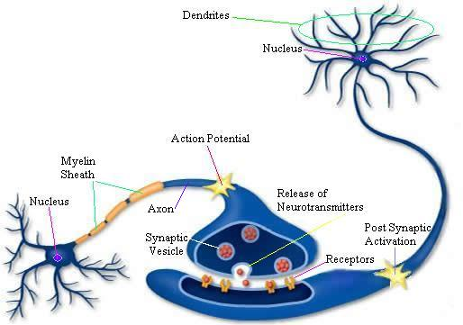
Neurotransmission
Notes:
5

Slide 6

Neurotransmission & Addiction

Slide 7
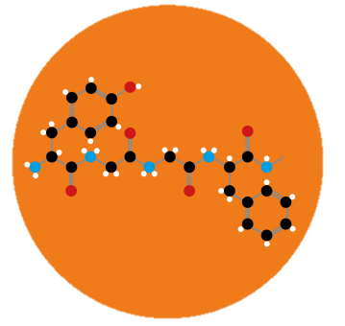
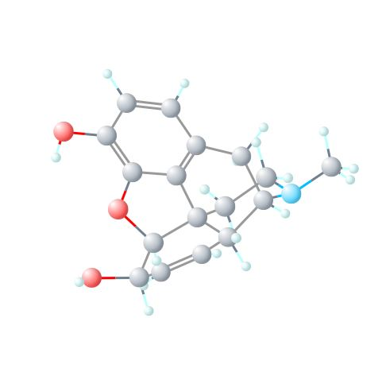
Endorphins vs. Morphine

Slide 8
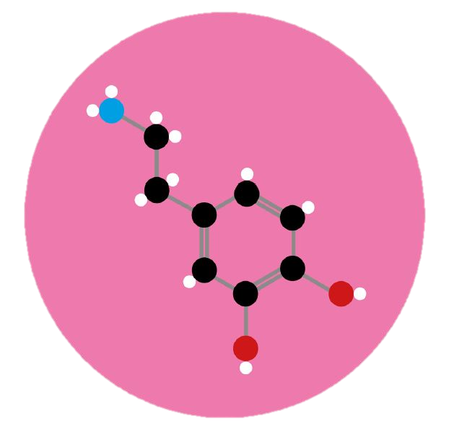
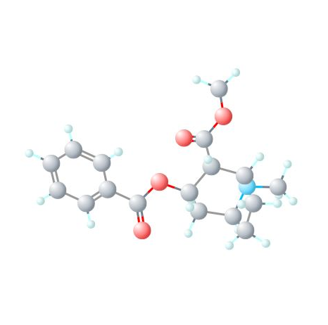
Dopamine vs. Cocaine

Slide 9
Neurotransmitters
          Endorphins/ Enkephalins
          Serotonin
          Norepinephrine
          Dopamine
          Acetylcholine
Notes:
9

Slide 10
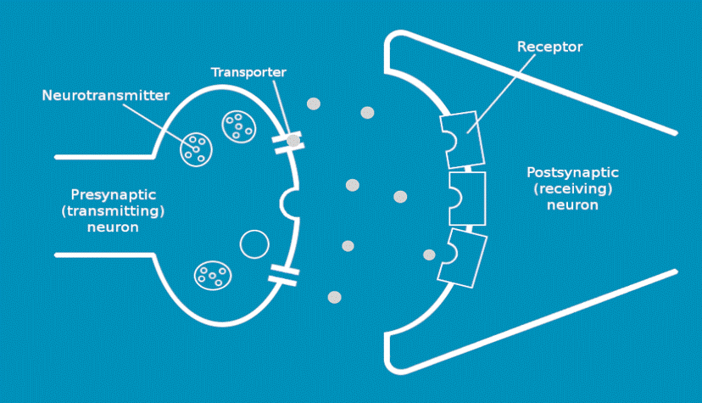
Neurotransmission & Addiction

Slide 11
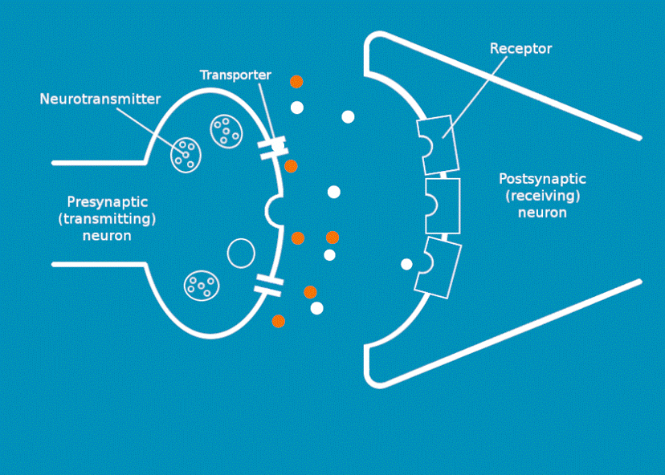
Neurotransmission & Addiction

Slide 12
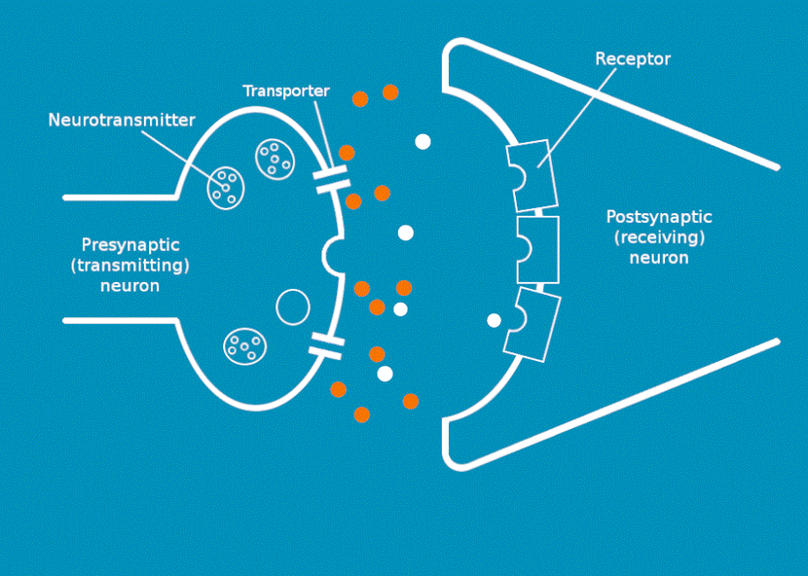
Neurotransmission & Addiction

Slide 13
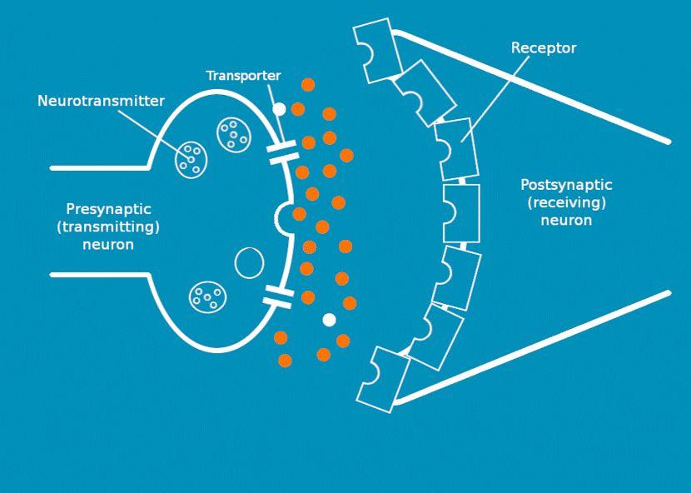
Neurotransmission & Addiction

Slide 14
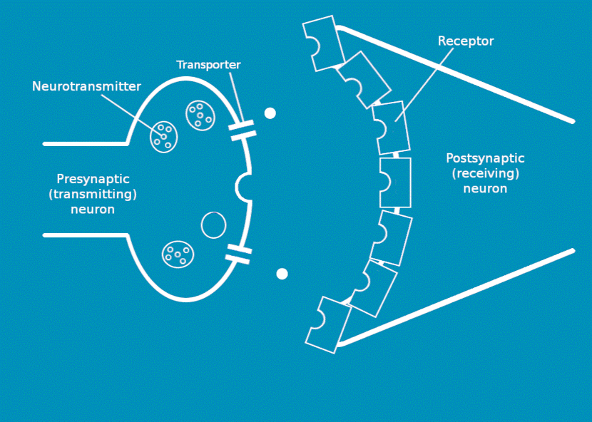
Neurotransmission & Addiction

Slide 15
Addictive Disease
              Progressive
              Chronic
              Fatal
Notes:
15

Slide 16
Addictive Disease
Full Remission
Harm Reduction
Prevention
Notes:
16

Slide 17
Re-Stabilize Brain Chemistry
              Abstinence
              Nutrition
              Stress Prevention
Notes:
17

Slide 18
Vulnerability to Addictive Disease
50% - 60% GENETIC
40% - 50% ENVIRONMENTAL
Early Onset of Use
Chemical Environment
Adverse Childhood Experiences
Poor Nutrition
High Stress Levels
Inadequate Coping Skills
Chronic Illness
Grief & Loss
Notes:
18

Slide 19
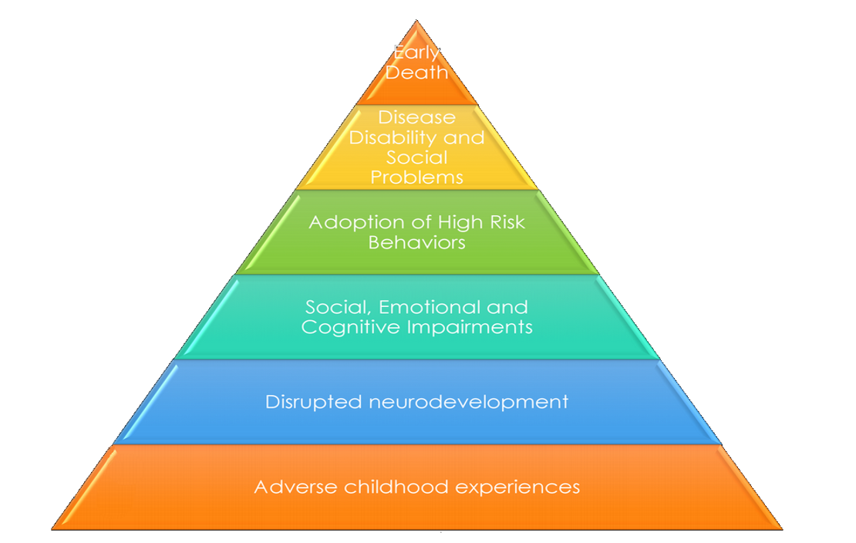
Adverse Childhood Experiences
Death
www.ACEStudy.org
www.cdc.gov/ace
Whole Life Perspective
Birth
Mechanisms by Which Adverse Childhood Experiences influence Health and Wellbeing Through the Lifespan
R. Fallot, Ph.D.
© S. Covington, Ph.D., 2016
Notes:
ACE Slides Standard
19
Fallot/Community Connections/2008
202.608.4796/rfallot@ccdc1.org
19
10/19/17

Slide 20
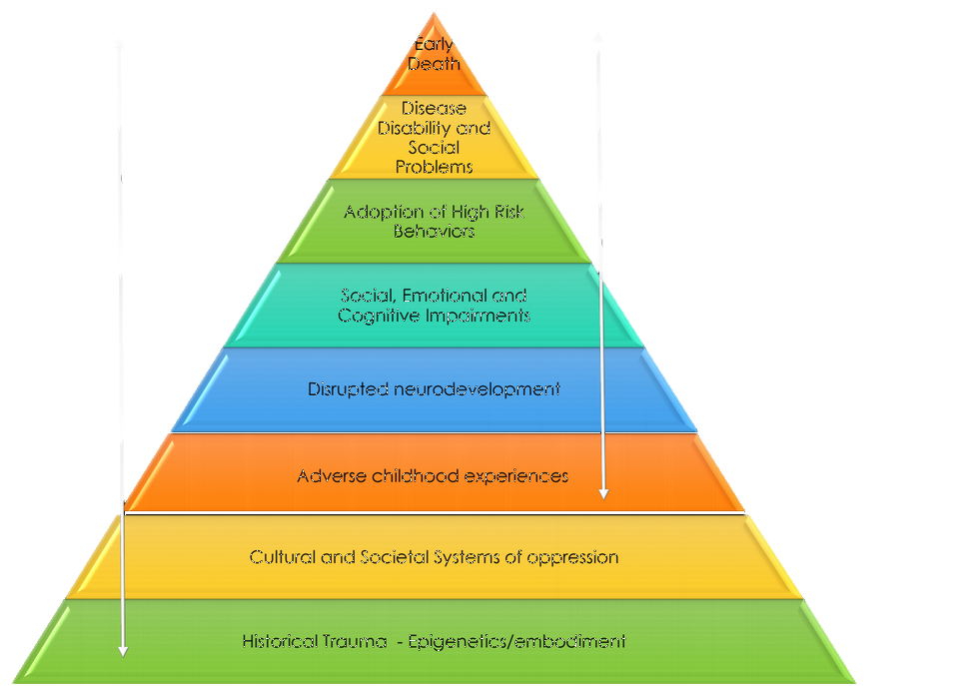
Adverse Childhood Experiences
Death
Birth
History
Notes:
ACE Slides Standard
20
Fallot/Community Connections/2008
202.608.4796/rfallot@ccdc1.org
20
10/19/17

Slide 21
Definition of Trauma
Trauma occurs when an external event
overwhelms a person’s physical and
psychological coping mechanisms or strategies.
(Van der Kolk, 1989)
© S. Covington, Ph.D., 2016

Slide 22
Definition of Toxic Stress
Toxic stress is a strong, unrelieved experience
that can adversely affect healthy development, particularly in a child. Without caring adults to
buffer children, the unrelenting stress caused by extreme neglect, poverty, or abuse can weaken the
developing brain and have long-term consequences
on both physical and mental health.
(National Scientific Council on the Developing Child 2007)
© S. Covington, 2016

Slide 23
Relentless Stress
Poverty or Near Poverty
Severe Injury
Illness in Close Family
Incarceration
Parenting Alone
Multi-challenged Children
Multigenerational Caregiving
Hunger
Racism
Sexism
Domestic Violence
Chronic Illness
Mental Illness
Bullying
S. Bloom

Slide 24
Trauma’s Impact on the Brain & Body
Person experiences trauma
Brain and body become overwhelmed; nervous system is unable to return to equilibrium
Trauma goes untreated; person stays in
“stress response” mode
Cues continue to trigger trauma
(e.g. loud voices, searches, cell extractions)
Person reacts to trauma cues
from a state of fear
© S. Covington, Ph.D., 2016

Slide 25
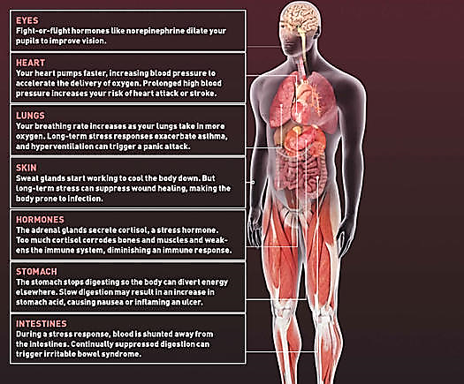
Notes:
25
25
Stephanie S. Covington, Ph.D.
Institute for Relational Development

Slide 26
Trauma and the Brain
    Trauma disrupts the chemistry of the brain and can predispose people to alcohol and drug use, eating disorders, self-injurious behavior and mental health problems
    When trauma occurs in childhood, it can have lasting effects on brain development
Notes:
26
26
Stephanie S. Covington, Ph.D.
Institute for Relational Development

Slide 27
Trauma and the Brain:
The Limbic System
Stores highly charged emotional events, positive and negative
Processes the sense of smell directly
Is the center of bonding and social connectedness
Sets emotional tone, attitude, shading
Tags events as internally important
Controls appetite and sleep cycle
Modulates libido (sexual desire)
When the limbic system is less active, you experience calm and a more positive attitude
Notes:
27
27
Stephanie S. Covington, Ph.D.
Institute for Relational Development

Slide 28
Trauma and the Brain:
The Limbic System
When the limbic system is inflamed (i.e., as a result of trauma or stress), you experience more negativity, hyperarousal and/or depression
The limbic system in women is proportionately larger than in men, providing them with increased ability to bond and experience and express emotions
This also makes women more susceptible to depression and other emotional imbalances
When the fear response is triggered, it is powerful and immediate
Notes:
28
28
Stephanie S. Covington, Ph.D.
Institute for Relational Development

Slide 29
Trauma and the Brain:
Neurotransmitter Disruption During the Stress Response
  Serotonin (responsible for emotional stability and homeostasis)
    When this system is disrupted, people experience depression
  and have a tendency to repeat maladaptive behaviors. This can
  also cause sleep and appetite irregularities
  Dopamine (responsible for drive and pleasure rewards)
    Disruption of this neurotransmitter can create low motivation,
    avoidance, or hyper-arousal
  Opioid Peptides (endogenous pain relievers)
    Disruption of this neurotransmitter can create a pain sensitivity,
    low pain tolerance, or numbing
Disruption of these systems can become chronic

Slide 30
Triggers
A trigger is an external stimulus that sets off
a physical or emotional reaction in a person.
The stimulus can be a sight, a sound, a smell,
a person, a place, a behaviour, or anything
that reminds you of the traumatic event.
© S. Covington, Ph.D., 2016
Notes:
Becoming Trauma Informed, UK Edition
30

Slide 31
Process of Trauma
Traumatic Event
Overwhelms the physical and psychological coping skills
Response to Trauma
Fight, Flight or Freeze
Altered state of consciousness, Body sensations,
Numbing, Hyper-vigilance, Hyper-arousal, Collapse
Sensitized Nervous System
Changes in the Brain
Brain-Body Connection
Psychological and Physical Distress
Current stressors, Reminders of trauma (triggers)
Sensations, Images, Behavior, Emotions, Memory
Emotional and/or Physical Responses
Retreat
Isolation
Dissociation
Depression
Anxiety
Harmful Behavior
to Self
Substance use disorders
Eating disorders
Deliberate self-harm
Suicidal actions
Harmful Behavior
to Others
Aggression
Violence
Rages
Threats
Physical Health
Issues
Lung disease
Heart disease
Autoimmune disorders
Obesity
© S. Covington, Ph.D., 2016
Notes:
Becoming Trauma Informed, UK Edition
31

Slide 32
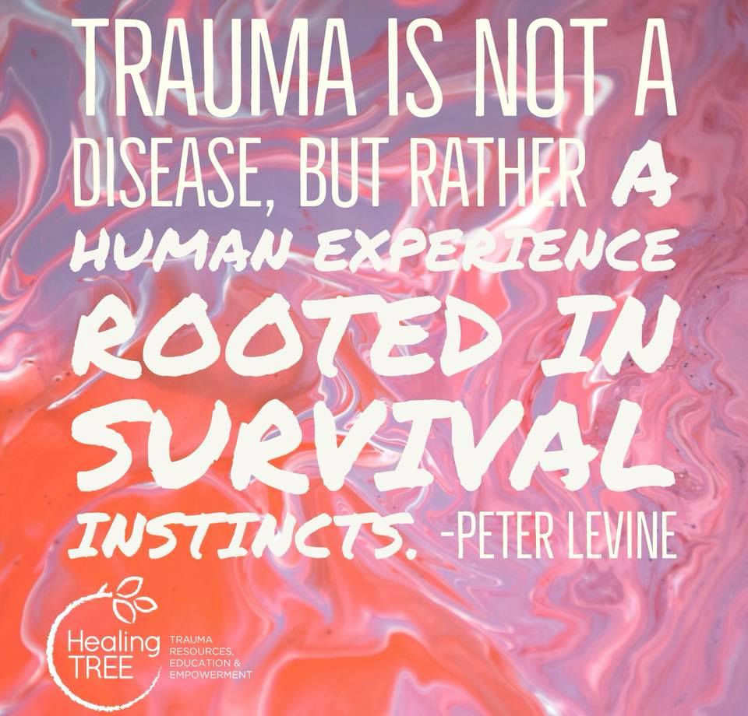

Slide 33
Vulnerability to Addictive Disease
50% - 60% GENETIC
40% - 50% ENVIRONMENTAL
Early Onset of Use
Chemical Environment
Adverse Childhood Experiences
Poor Nutrition
High Stress Levels
Inadequate Coping Skills
Chronic Illness
Grief & Loss
Notes:
33

Slide 34
Posttraumatic Growth
Positive changes from a major life crisis
Searching for good in the terrible
Beyond resilience
Catalyst for higher level of functioning
Calhoun and Tedeshchi 1999, 2013

Slide 35
Posttraumatic Growth (cont.)
Personal Strength
Vulnerability → Powerlessness can paradoxically boost self-confidence
Relationships
Bonding on a deeper level after tragedy
Greater Life Appreciation
Can shift perspective to focus on gratitude and joy
Beliefs
May change or be reinforced by grief
New Possibilities
Perceive new opportunities and pursue them
Calhoun and Tedeshchi 1999, 2013

Slide 36
SEEDS
Five factors to promote healing of the brain:
Social Connectivity
Exercise
Education
Diet
Sleep
© S. Covington, 2015

Slide 37
SEEDS
S Social Connectivity
Being in connection and relationship with others
E Exercise
Thirty minutes a day can make a big difference
E Education
Learn something new each day
D Diet
The food we eat either nourishes or starves our brain
S Sleep
Our brains and our bodies need to rest and regenerate each day
© S. Covington, 2015

Slide 38
Happiness
Research indicates that spending 2 minutes each day doing 1 of these things for the next 21 days will increase your happiness:
1) Write down 3 things you’re grateful for
2) Write in your diary or journal about 1 positive experience
you’ve had in the last 24 hours
3) Learn to meditate, to teach your brain to focus
4) Use the first e-mail/text you write every day to praise or
thank someone you know, or say something nice to the
first person you see each day
Notes:
11/10/17
BTI Men, June 12, 2017 UK
38
11/10/17
BTI Men, June 12, 2017 UK
38
BTI Men, June 12, 2017 UK
38

Slide 39


Slide 40
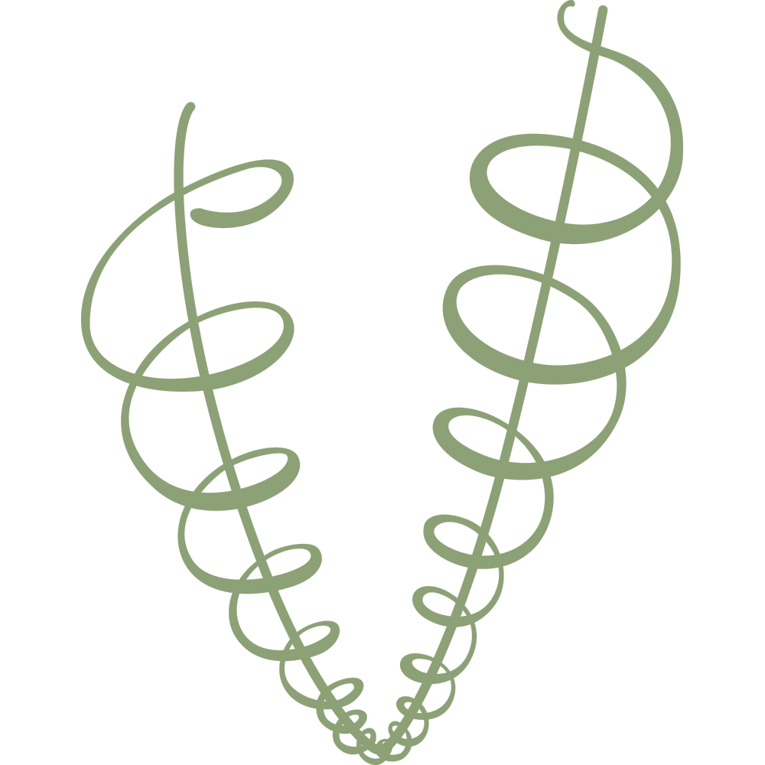
Spiral of Trauma,
Addiction, Recovery and Healing
Transformation
Trauma and
Addiction
(constriction)
Recovery and Healing (expansion)

Slide 42
Carol Ackley, LADC
Ackley Consulting and Training, LLC
rca0622@aol.com
612.961.3344

